Slide 1
Team: #A
Archives of Ontario

Slide 2
Who we are?
[‎01/‎31/‎2019 10:36 AM] Chan, Patrick (MGCS):
"record" means any record of information however recorded, whether in printed form, on film, by electronic means or otherwise
[‎01/‎31/‎2019 10:36 AM] Chan, Patrick (MGCS):
"record" means any record of information however recorded, whether in printed form, on film, by electronic means or otherwise
Since 1903 the Archives of Ontario has been collecting, managing and preserving the records of any format the Government of Ontario and promoting and facilitating access. The Archives of Ontario provides access to digital records to Ontarians.
“Record" means any record of information however recorded, whether in printed form, on film, by electronic means or otherwise.
Supports strategic direction of IPA to enhance digital capacity by strengthening our capacity to receive, manage, preserve and provide access to digital records.

Slide 3
Problem Statement - Original
Problem statement
Review and analyse various data sets [e.g. Ontario government archival records] to sort/categorize, providing new information [e.g., related archived records] and improving processes [e.g., faster and easier access to archival information].

Slide 4
Problem Statement - Revised
Challenges:
Digital content has exponentially grown the number of records transferred and made available for access by the archives.
Increased resource time spent assessing, analyzing and describing content without the proper tools to do this work.
Minimal automation resulting in lots of manual intervention.
Defined problem and solution:
Minimize processing time and effort for record listing and creating descriptive tags and metadata to identify and locate records.

Slide 5
Collaborative, Multi-disciplinary Team
The IPA and GISC team brought subject matter knowledge in:
Archival and information management
Recordkeeping, access and privacy
Python, File I/O and data manipulation
Led by the Compute Ontario team of Fei, Shaikh, Jamie, Matt and Dennis.
The common goal for the team was to learn more about AI concepts and tools and to understand what problems could be solutioned and how it could benefit our work.

Slide 6
Approach to Applying AI
Developing the solution using open source software, no licensing dependencies on any commercial software required.
ETL to pull data from IPA repository to train a model for machine learning.
Extract – reading data from IPA repository
Transform – converting the extracted data using Python
Load – writing data into the new database
Traditional machine learning to generate an output file list with related document tags.
Future opportunities to train a deep learning model.

Slide 7
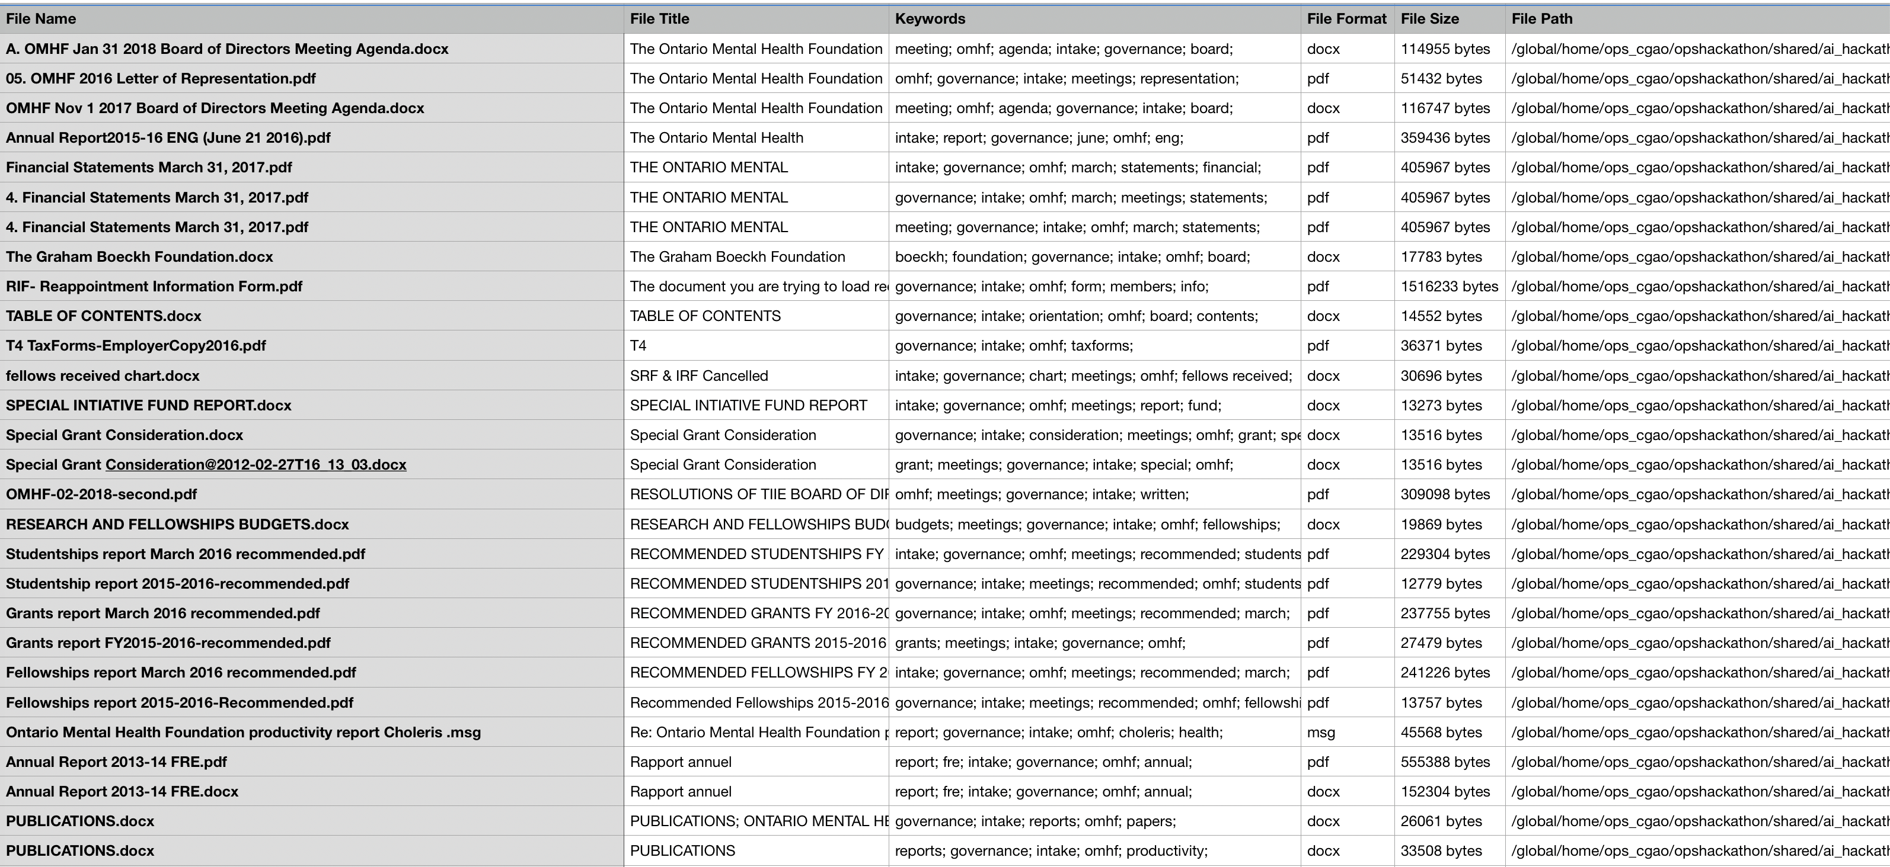
Summary of Solution

Slide 8
Business impact
The prototype has an immediate benefit as it could be used to provide access points for transferred unprocessed digital records in particular legal discovery and freedom of information requests.
Further adaptation by the Archives team could create additional business benefits for listing, organizing and providing access to digital records.
Using the machine learning model for text classification the Archives team can further define tags, refine and train the model with new tags over time for greater accuracy.
Creates efficiencies e.g. 1542 files – 136 hours effort – 13 minutes for one computer to run programme.

Slide 9
Key Learning
Clearly define the business problem!
Apply the highest value automation tool i.e., least effort & best results. AI is not always the highest value tool.
Articulate the clear inputs and outputs of the problem, related business processes, and the inputs and outputs of the relevant process steps
Having the right preparation of the data and human knowledge for the solution (coding 25%, data prep 75%). Have a big enough dataset to train the model.
Improving OPS data management will lead to significant process improvements and opportunities.

Slide 10
Where to next?
People
Invest in staff development and build digital competencies.
Policy and Processes
Improve data and information management.
Articulate and modernize business processes and practices.
Technology
Create IT infrastructure for staff to create and apply tools.

